Slide 1
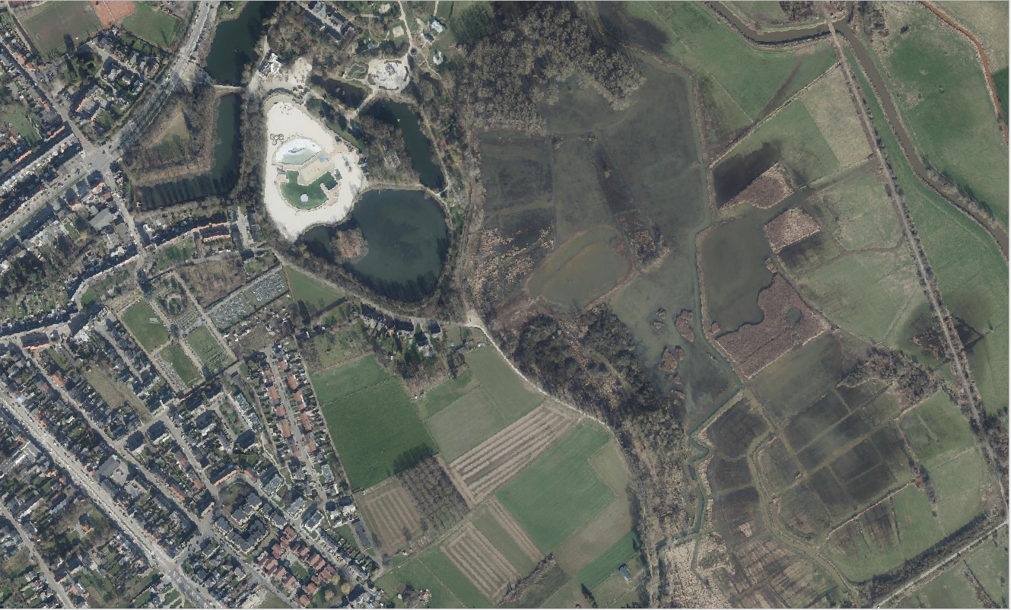
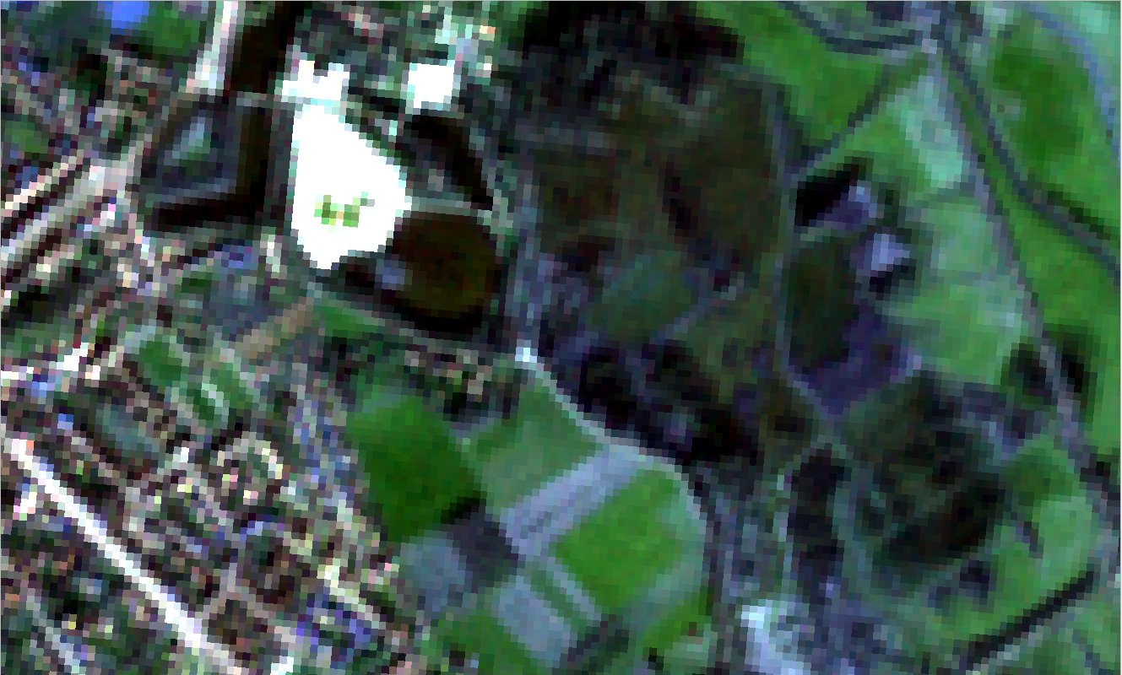
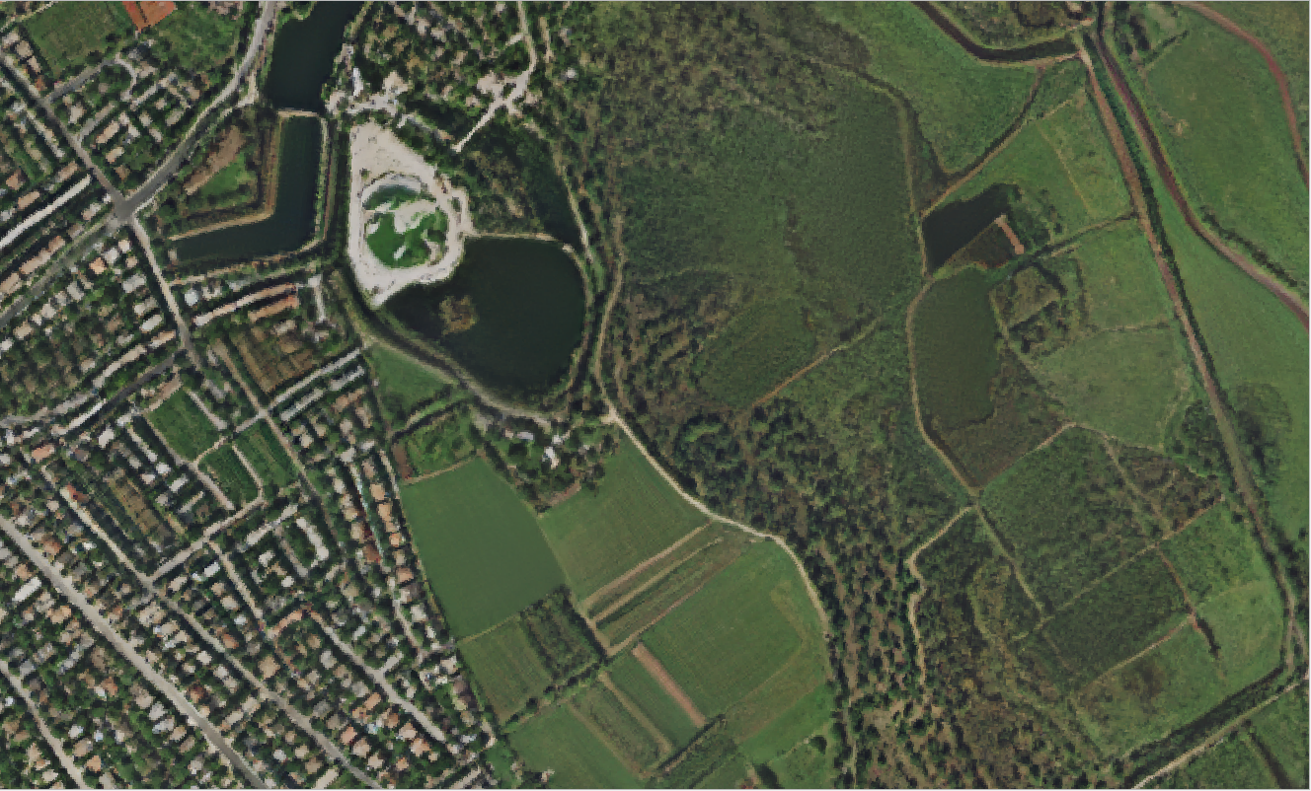
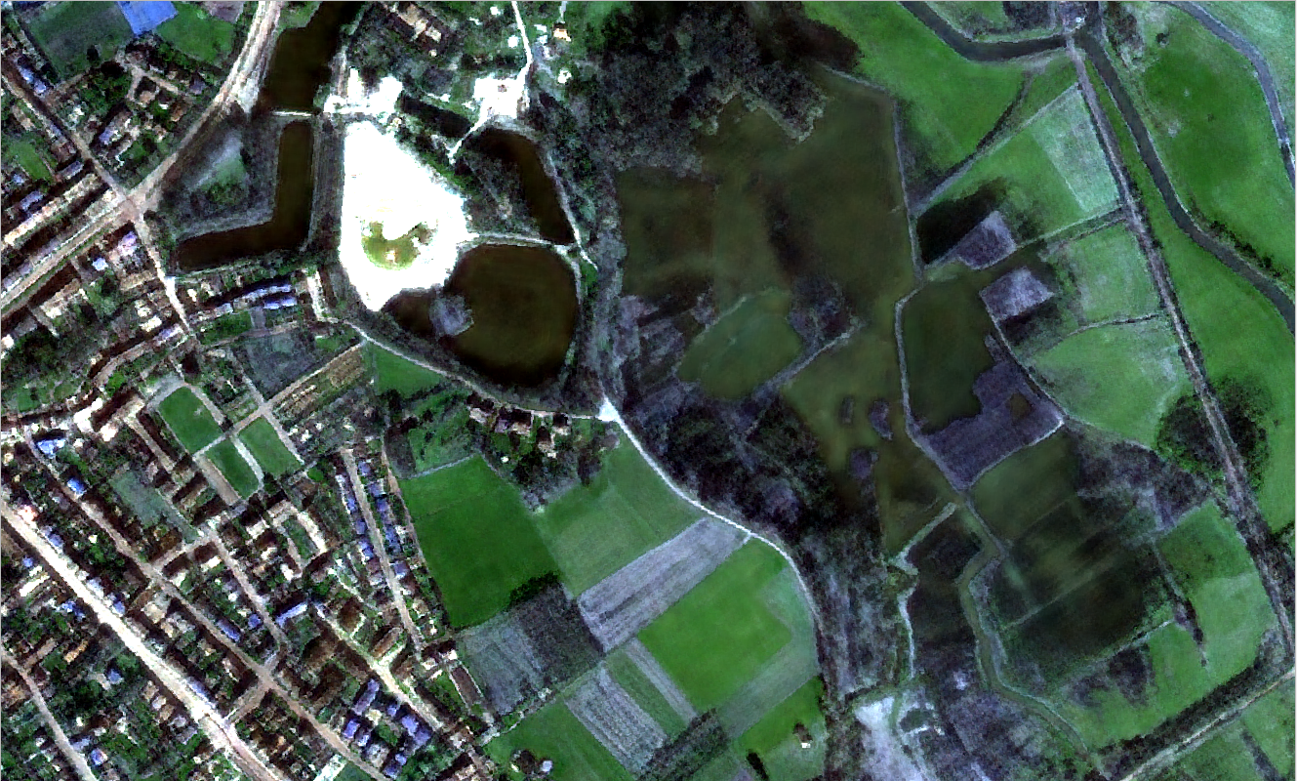
Ortho image (2023-03-01) (15cm/pxl)
S2 RGB image (2023-03-01) (10m/pxl)
Metria (1 input image: 2023-03-01) (2.5m/pxl)
S2DR3T RGB image (2023-03-01) (1m/pxl)

Slide 2
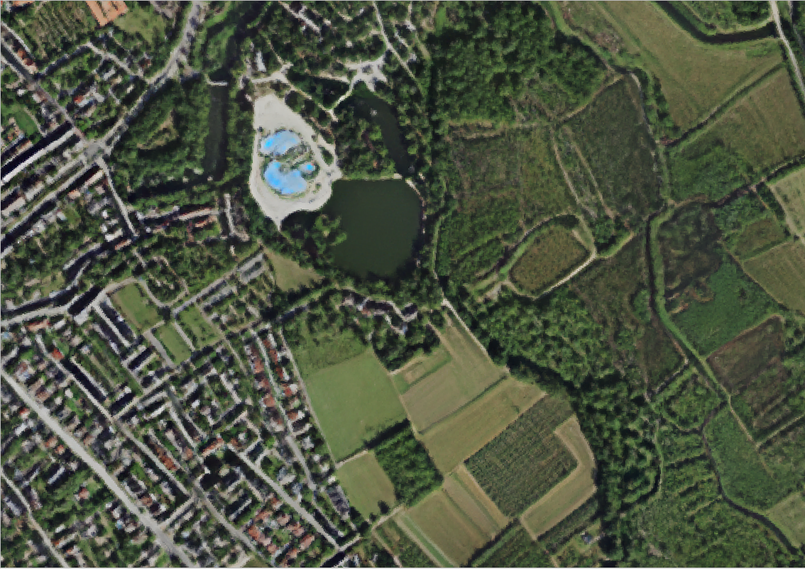
Ortho image (2023-03-01) (15cm/pxl)
S2 RGB image (2023-03-01) (10m/pxl)
Metria (8 input images: 2023-06) (2.5m/pxl)
S2DR3T RGB image (2023-03-01) (1m/pxl)

Slide 3
Ortho image (2023-03-01) (15cm/pxl)
S2 RGB image (2023-03-01) (10m/pxl)
Metria (1 input image: 2023-03-01) (2.5m/pxl)
S2DR3T RGB image (2023-03-01) (1m/pxl

Slide 4
Ortho image (2023-03-01) (15cm/pxl)
S2 RGB image (2023-03-01) (10m/pxl)
Metria (8 input images: 2023-06) (2.5m/pxl)
S2DR3T RGB image (2023-03-01) (1m/pxl

Slide 5
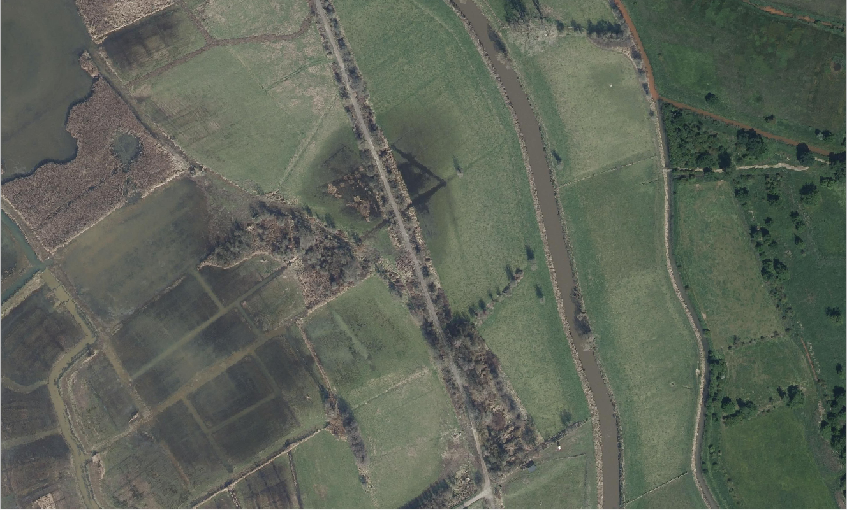
Ortho image (2023-03-01) (15cm/pxl)
Reeds
Inundated “woody” area
Rivers
Open area with
inundated ditches
Wood edges

Slide 6
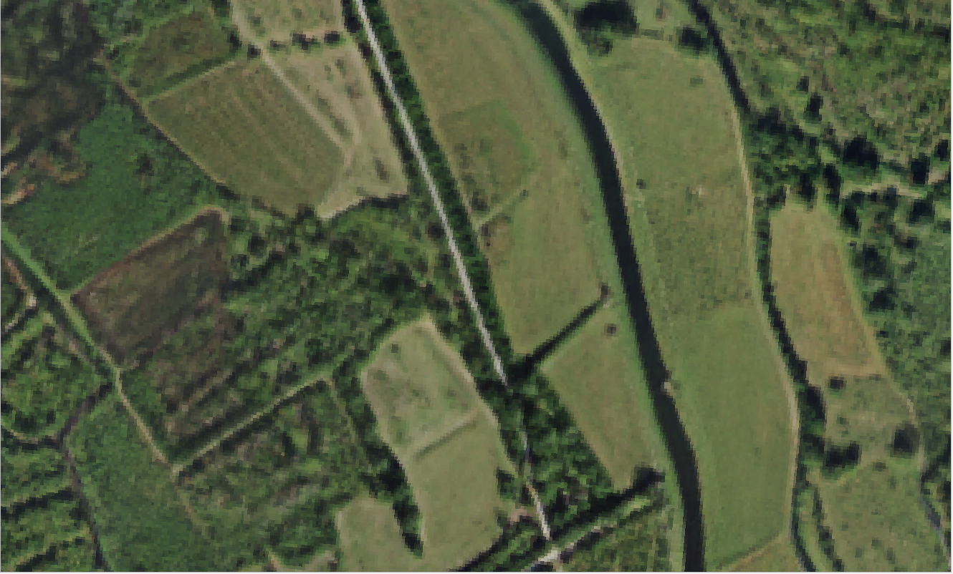
Metria (8 input images: 2023-06) (2.5m/pxl)
Reeds
Inundated “woody” area
Rivers
Open area with
inundated ditches
Wood edges

Slide 7
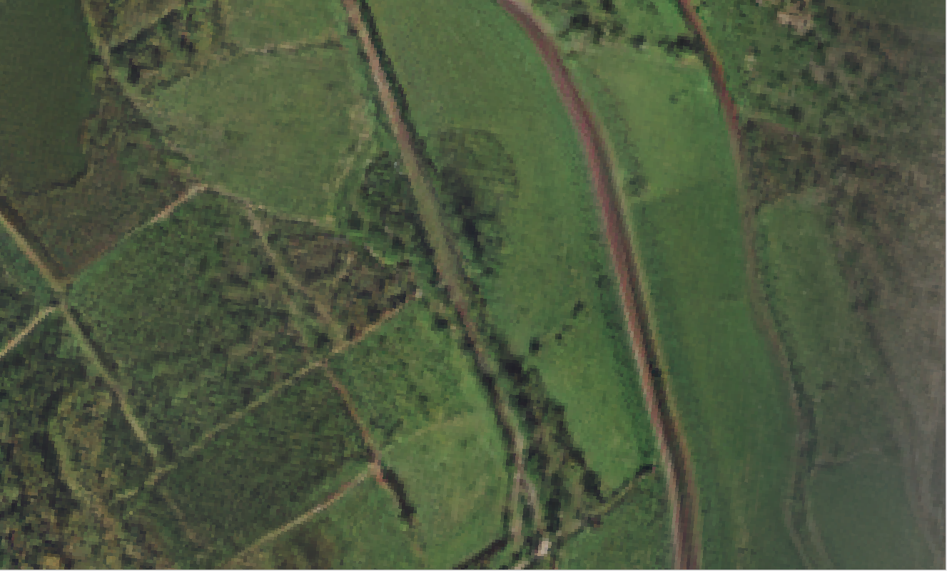
Metria (1 input image: 2023-03-01) (2.5m/pxl)
Reeds
Inundated “woody” area
Rivers
Open area with
inundated ditches
Wood edges

Slide 8
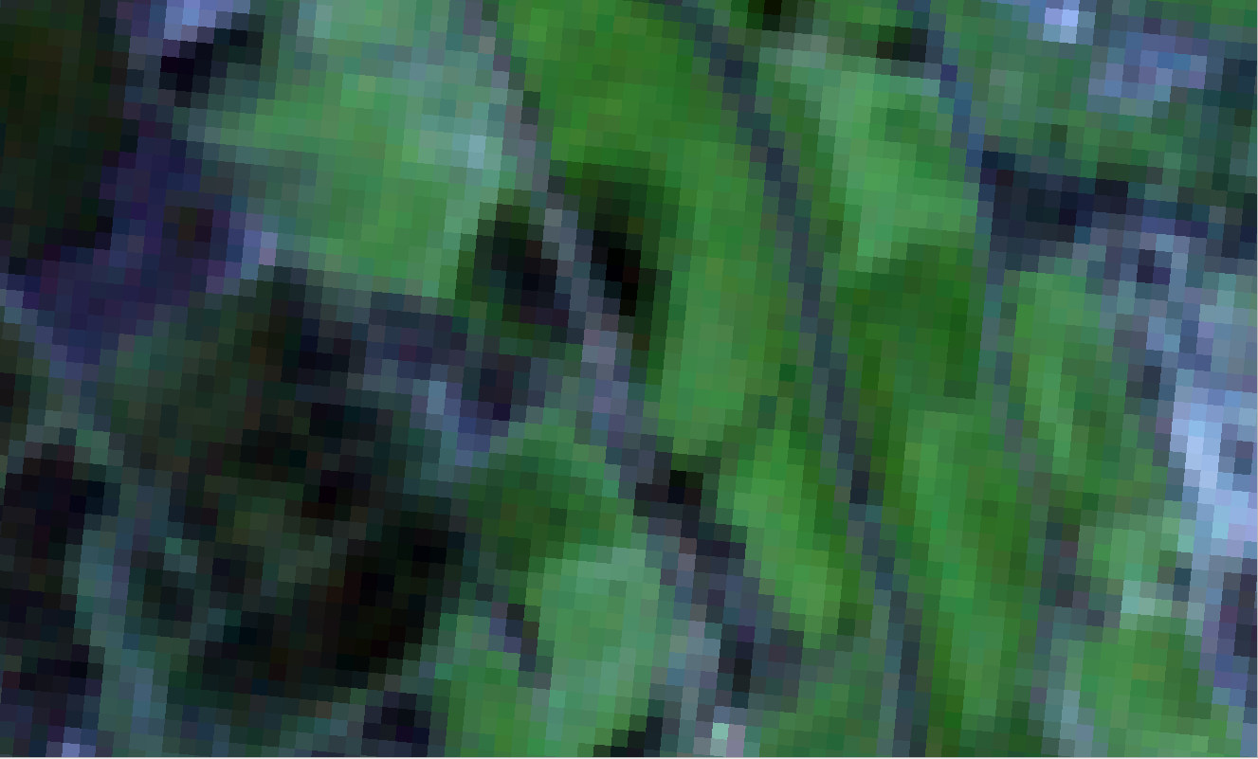
S2 RGB image (2023-03-01) (10m/pxl)
Reeds
Inundated “woody” area
Rivers
Open area with
inundated ditches
Wood edges

Slide 9
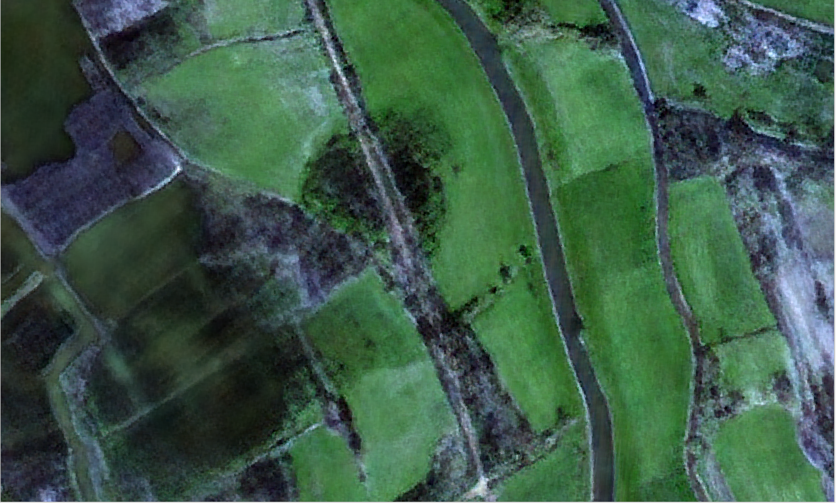
S2DR3T RGB image (2023-03-01) (1m/pxl
Reeds
Inundated “woody” area
Rivers
Open area with
inundated ditches
Wood edges

Slide 10
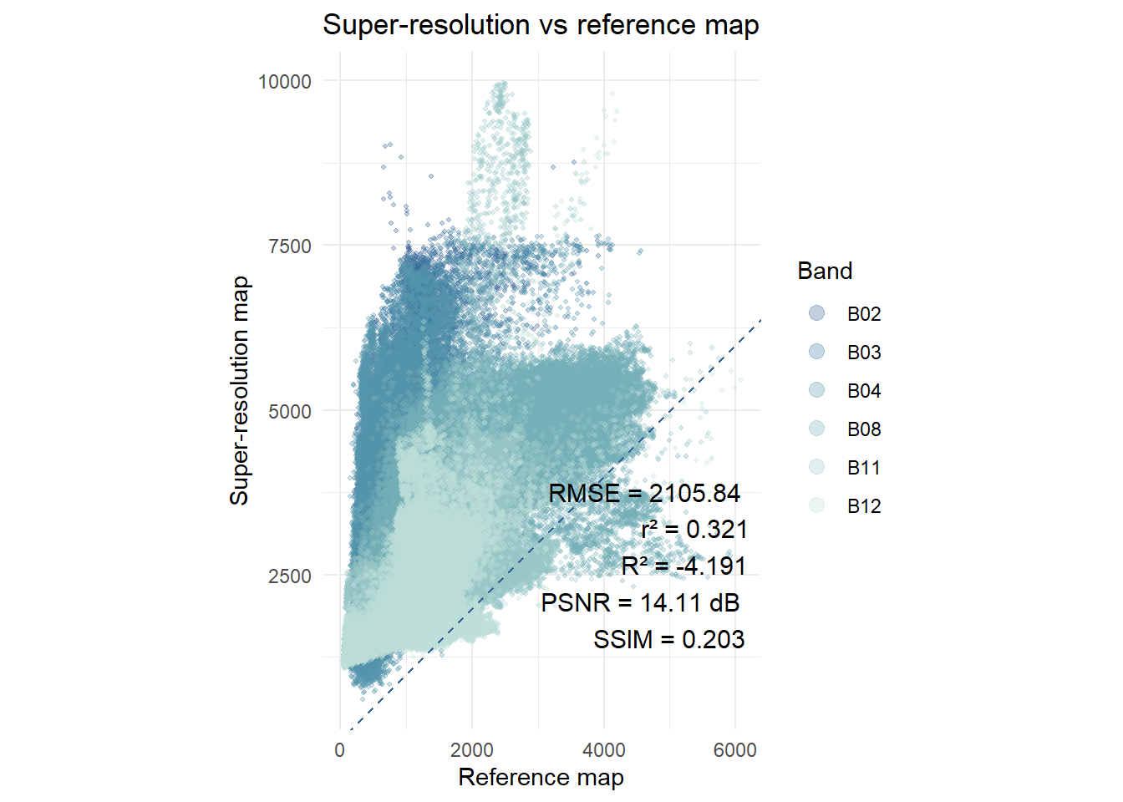
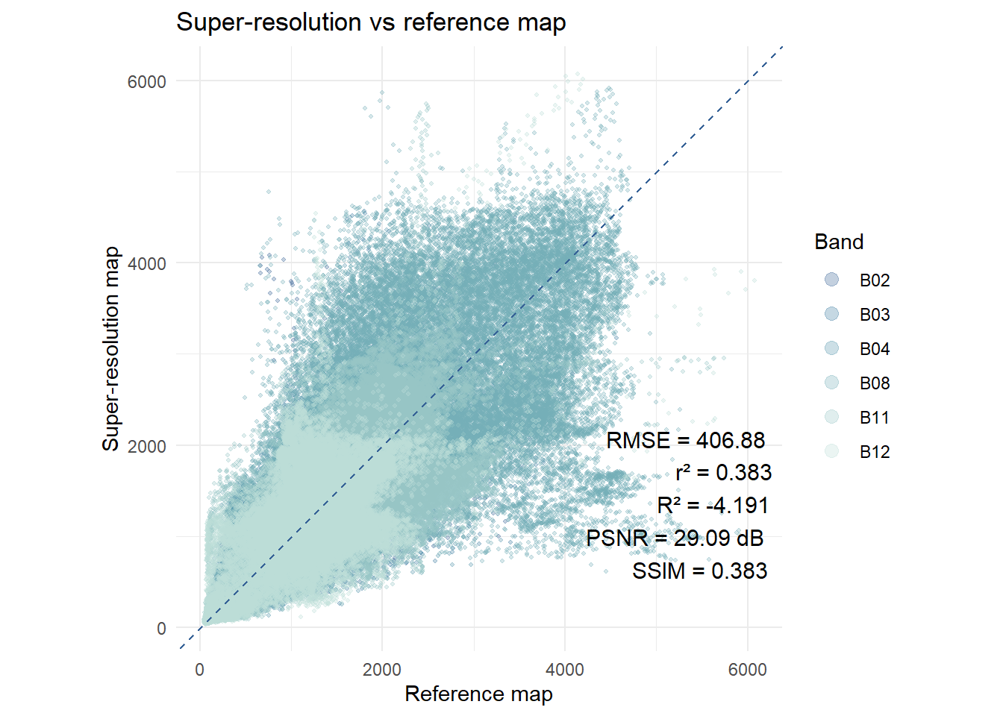
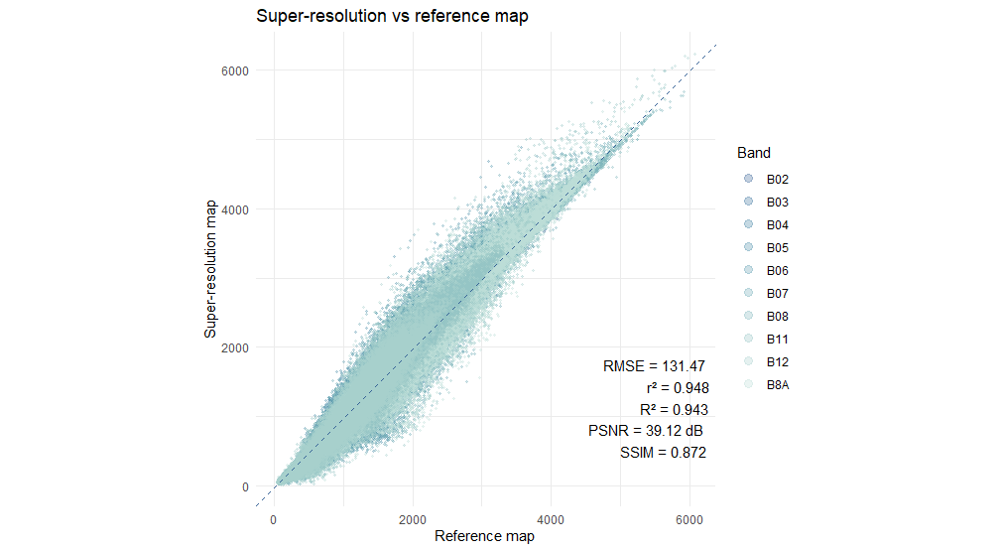
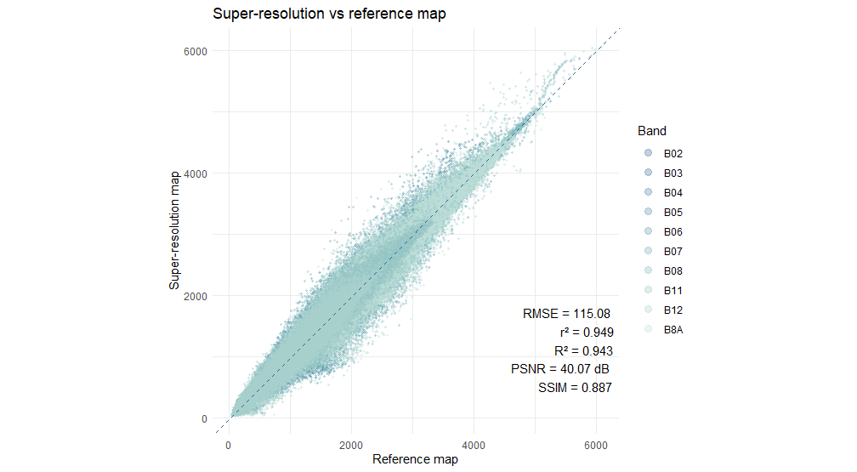
Metria (2023-06 (8 input images) – rescaled) & Sentinel-2
Metria & Sentinel-2 – histogram matched
Big time difference between Metria image and S2
S2DR3T (2023-03-01 – rescaled) & Sentinel-2
S2DR3T & Sentinel-2 – histogram matched

Slide 11
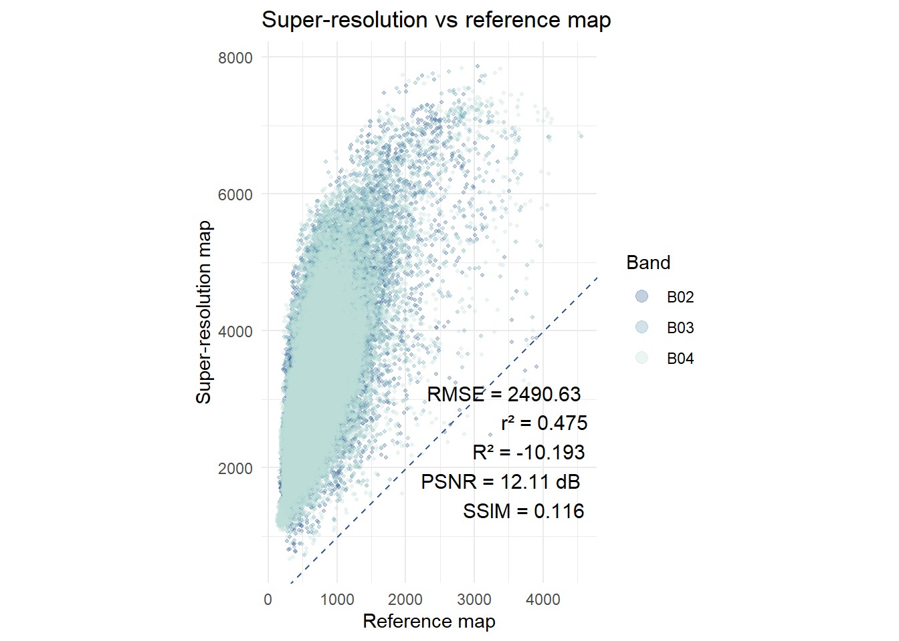
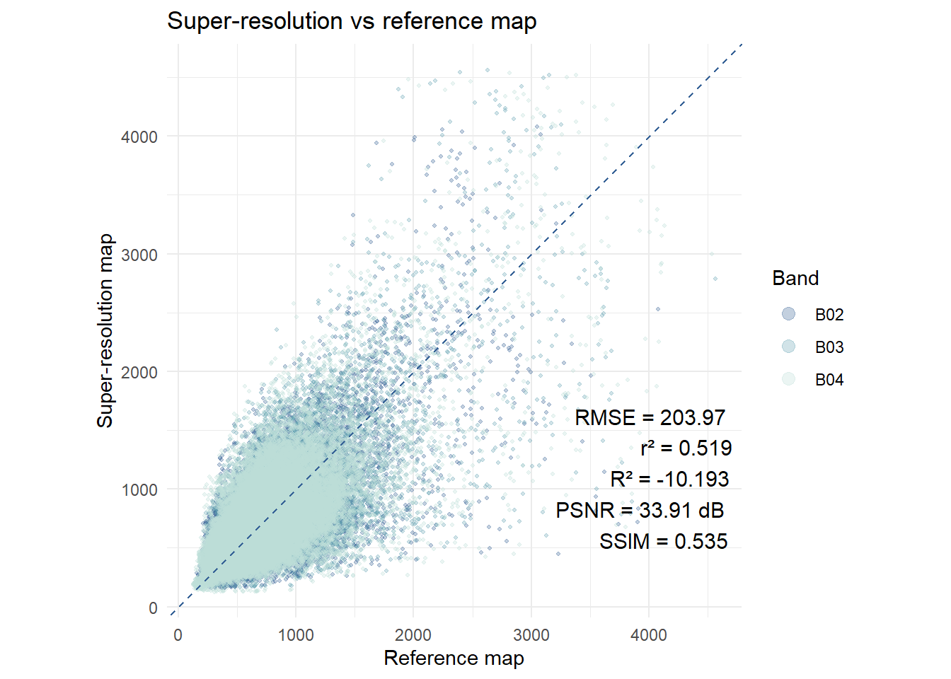
Metria (2023-03-01 (1 input image) - rescaled) & Sentinel-2
Metria & Sentinel-2 – histogram matched
No time difference between Metria image and S2

Slide 12
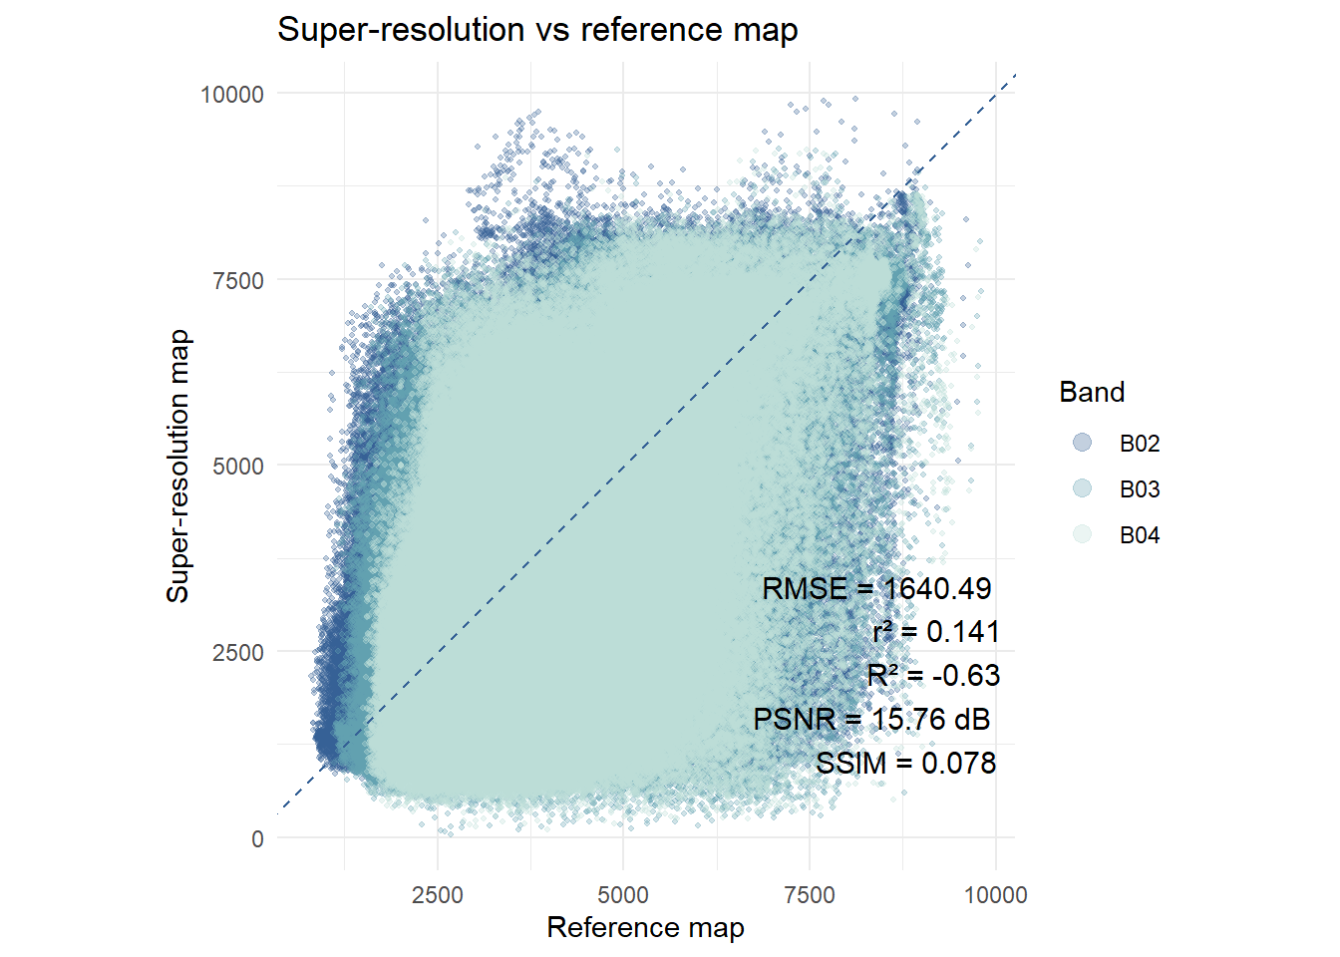
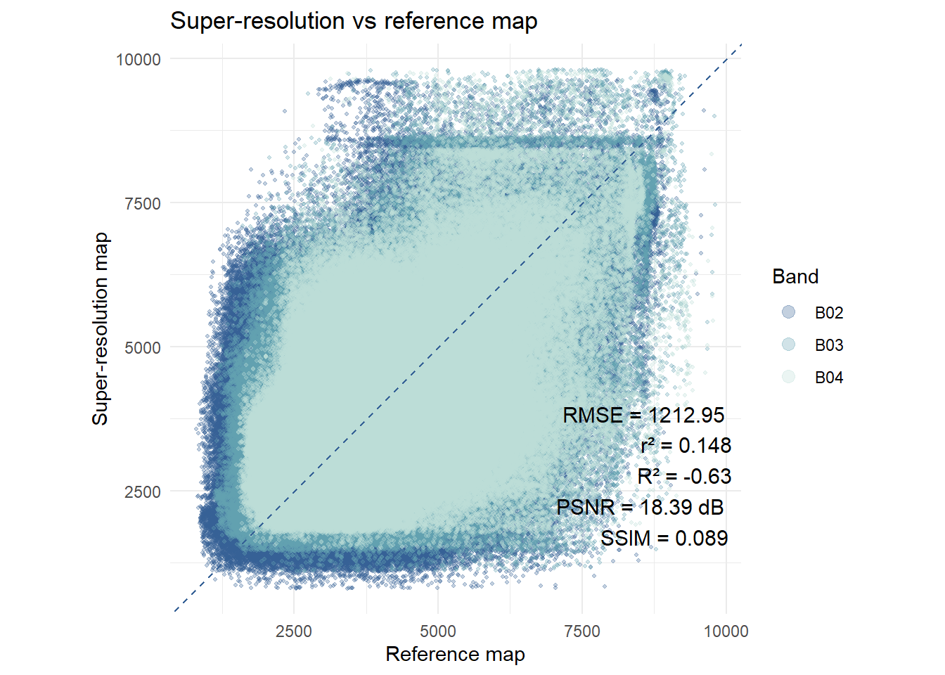
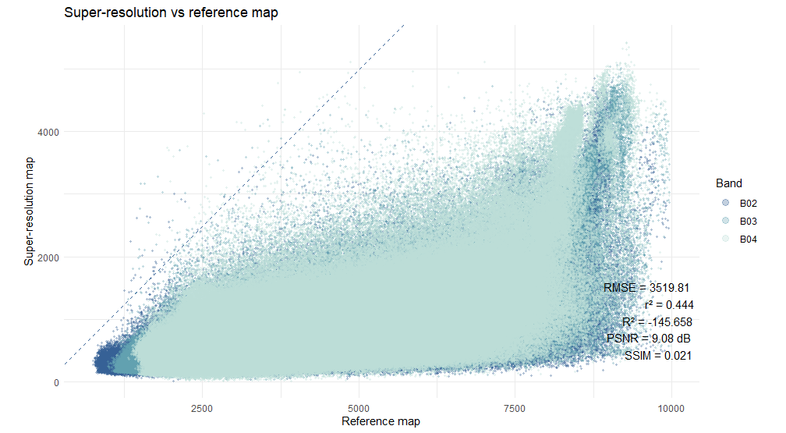
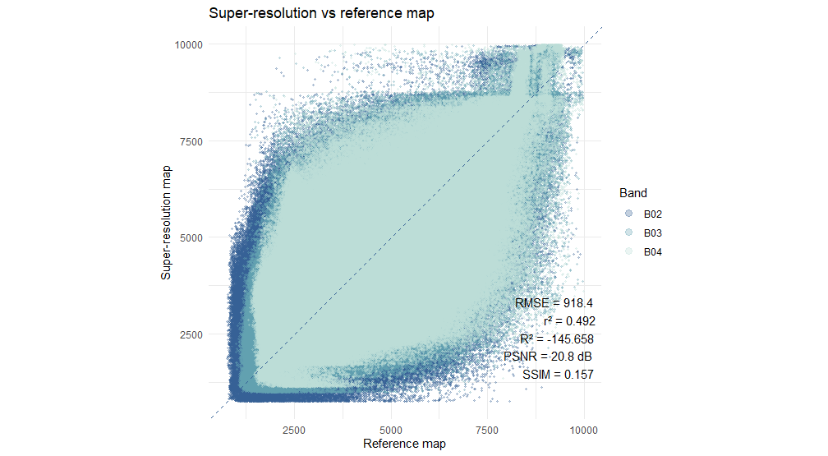
Metria (2023-06 (8 input images)) & Orthophoto 2023 (rescaled)
Metria & Orthophoto – histogram matched
S2DR3T (2023-03-01) & Orthophoto 2023 (rescaled)
S2DR3T & Orthophoto – histogram matched

Slide 13
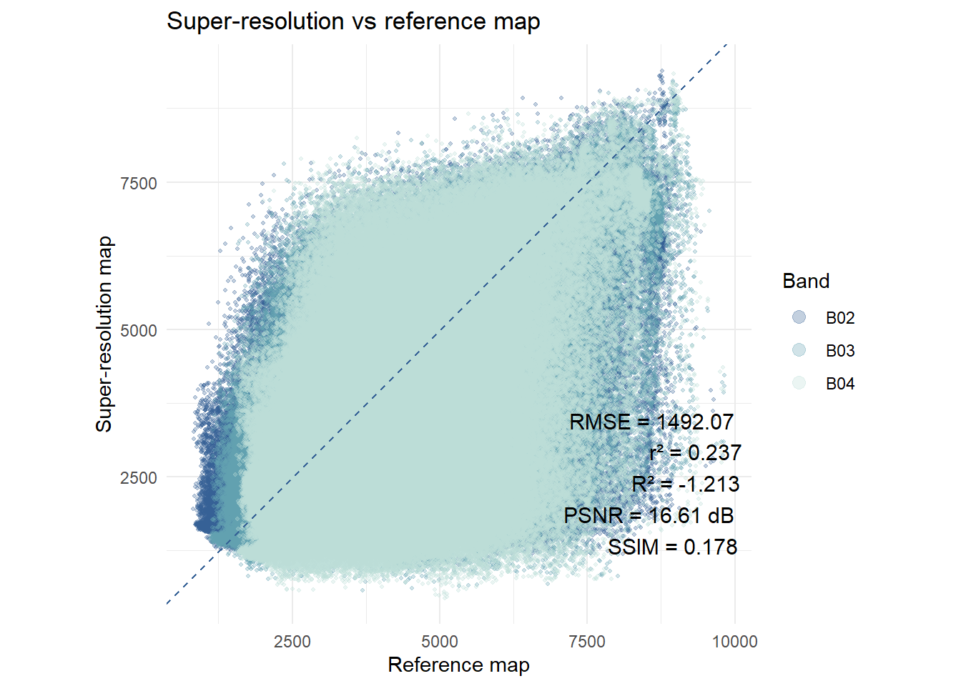
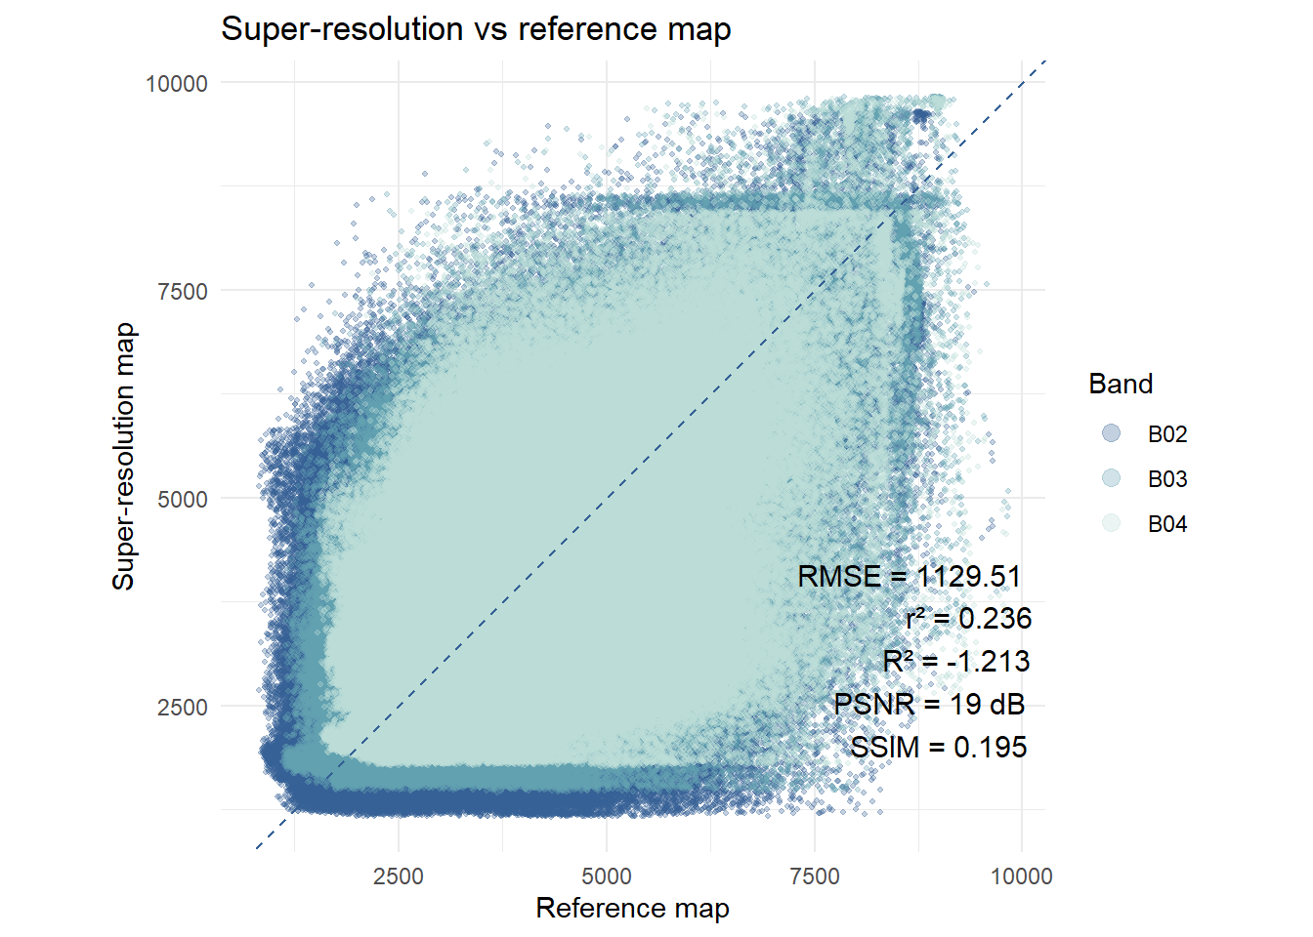
Metria (2023-03-01) & Orthophoto 2023 (downscaled)
Metria & Orthophoto – histogram matched
One remark: when we compare with the ortho image, can we really evaluate the difference between the S2DR3T and the Metria super resolution images? We downscale the ortho image to a different spatial resolution (1 m/pxl vs 2.5 m/pxl) -> so les pixels for the Metria comparison. This by itself will have an effect on the RMSE, r², PSNR and SSIM?

